Slide 1
HDLC
Prepared by
Divya K S
Adi Shankara Institute of Engineering & Technology
Kalady

Slide 2
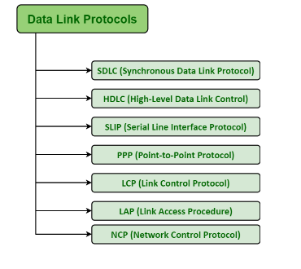
Data Link layer protocols

Slide 3
High-Level Data Link Protocol (HDLC)
High-level Data Link Control (HDLC) is a group of communication protocols of the data link layer for transmitting data between network points or nodes.
Since it is a data link protocol, data is organized into frames.
It is a bit - oriented protocol that is applicable for both point - to - point and multipoint communications.
HDLC protocol embeds information in a data frame that allows devices to control data flow and correct errors
HDLC uses similar format and mechanisms as that of other essential data link protocols.
It also supports full-duplex communication or transmission as well as half-duplex communication or transmission.

Slide 4
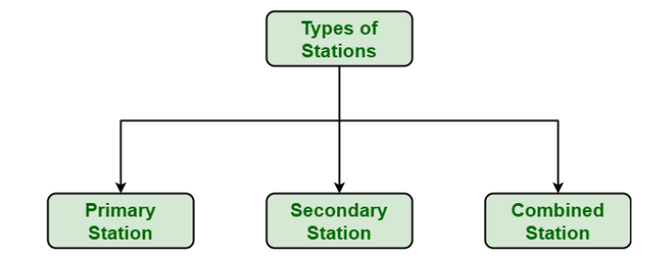
Types of Stations in HDLC
HDLC generally specifies the three types of stations for data link control as given below :

Slide 5
Primary Station :
Primary Station simply takes care of data link management.
The main responsibility of primary station is to control operation of all other stations on links.
It usually acts as master and controls operation of secondary stations and also handles error recovery at data link layer.
It also manages and controls connection to all secondary sessions by sending commands. ( frames issued by the primary station are commonly known as commands.)

Slide 6
Secondary Station :
Secondary stations generally give responses to commands that are sent from primary station.
This station act as slave and basically operates and works under control of primary station.
It only transmits or sends response frame when this response frame is being requested by primary station.

Slide 7
Combined Station
The combined station acts as both Primary stations as well as Secondary stations.
The combined station issues both commands as well as responses.

Slide 8
Transfer Modes
HDLC supports two types of transfer modes
Normal response mode
Asynchronous balanced mode.

Slide 9
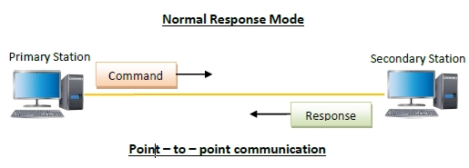
Normal Response Mode (NRM) −
Here, two types of stations are there, a primary station that send commands and secondary station that can respond to received commands.
It is used for both point - to - point and multipoint communications.

Slide 10
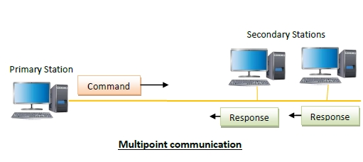
Normal Response Mode (NRM) −

Slide 11
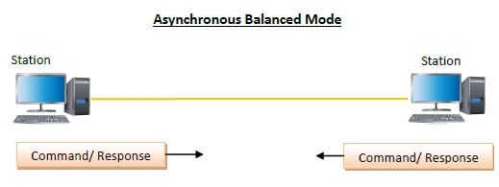
Asynchronous Balanced Mode (ABM)
Here, the configuration is balanced, i.e. each station can both send commands and respond to commands.
It is used for only point - to - point communications.

Slide 12
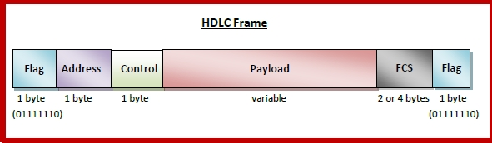
Frame structure of HDLC
HDLC is a bit - oriented protocol where each frame contains up to six fields

Slide 13
Frame structure of HDLC
Flag − It is an 8-bit sequence that marks the beginning and the end of the frame. The bit pattern of the flag is 01111110.
Address − It contains the address of the receiver. If the frame is sent by the primary station, it contains the address(es) of the secondary station(s). If it is sent by the secondary station, it contains the address of the primary station. The address field may be from 1 byte to several bytes.
Control − It is 1 or 2 bytes containing flow and error control information.
Payload − This carries the data from the network layer. Its length may vary from one network to another.
FCS − It is a 2 byte or 4 bytes frame check sequence for error detection. The standard code used is CRC (cyclic redundancy code)

Slide 14
Types of HDLC Frames
There are three types of HDLC frames. The type of frame is determined by the control field of the frame −
I-frame or Information frames
S-frame or Supervisory frames
U-frame or Un-numbered frames

Slide 15
Types of HDLC Frames
I-frame −
I-frames or Information frames carry user data from the network layer.
They also include flow and error control information that is piggybacked on user data.
The first bit of control field of I-frame is 0.
S-frame −
S-frames or Supervisory frames do not contain information field.
They are used for flow and error control when piggybacking is not required.
The first two bits of control field of S-frame is 10.
U-frame −
U-frames or Un-numbered frames are used for miscellaneous functions, like link management.
It may contain an information field, if required.
The first two bits of control field of U-frame is 11.

Slide 16
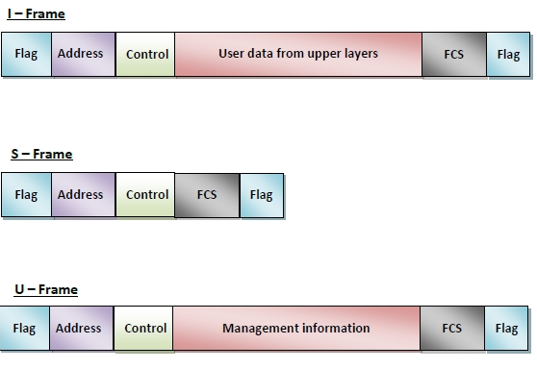
Types of HDLC Frames

Slide 17
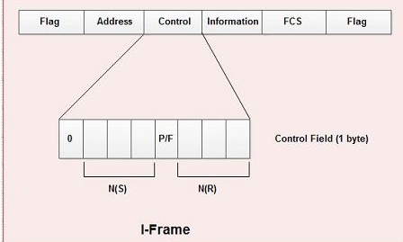
Contents of the Control field for I frame

Slide 18
Contents of the Control field for I frame
The first bit of control field is always zero, i.e. the presence of zero at this place indicates that it is I-frame.
Bit number 2, 3 & 4 in control field is called N(S) that specifies the sequence number of the frame.
Thus it specifies the number of the frame that is currently being sent. Since it is a 3.bit field, only eight sequence numbers are possible 0, 1,2,3,4,5,6, 7 (000 to 111).

Slide 19
Contents of the Control field for I frame
Bit number 5 in control field is P/F i.e. Poll/Final .
The P/F field is a single bit with a dual purpose.
It has meaning only when it is set (bit = 1) and can mean poll or final.
It means poll when the frame is sent by a primary station to a secondary (when the address field contains the address of the receiver).
It means final when the frame is sent by a secondary to a primary (when the address field contains the address of the sender).
• Bit number 6, 7, and 8 in control field specifies N(R) i.e. the sequence number of the frame expected in return in two-way communication.
If last frame received was error-free then N(R) number will be that of the next frame is sequence. If the last frame was not received correctly, the N(R) number will be the number of the damaged frame, asking for its retransmission.

Slide 20
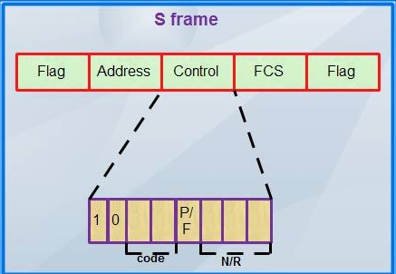
Contents of the Control field for S frame

Slide 21
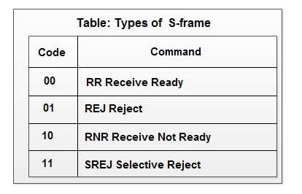
Contents of the Control field for S frame
The first two bits in the control field of S-frame are always 10.
Then there is a bit code field that specifies four types of S-frame with combination 00,01, 10, 11 as shown in table :-

Slide 22
Contents of the Control field for S frame
RR, Receive Ready-used to acknowledge frames when no I-frames are availab1e to piggyback the acknowledgement.
REJ Reject-used by the receiver to send a NAK when error has occurred.
RNR Receive Not Ready-used for flow control.
SREJ Selective Reject-indicates to the transmitter that it should retransmit the frame indicated in the N(R) subfield.
• There is no N(S) field in control field of S-frame as S-frames do not transmit data.
P/F bit is the fifth bit and serves the same purpose as discussed earlier.
Last three bits in control field indicates N(R) i.e. they correspond to the ACK or NAK value.

Slide 23
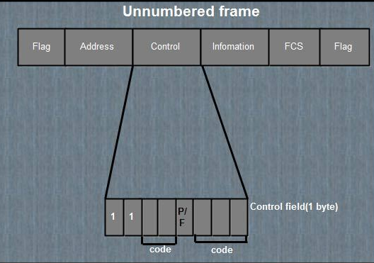
Contents of the Control field for U frame

Slide 24
Contents of the Control field for U frame
U-frames are reserved for system management and information carried by them is used for managing the link
U-frames are used to exchange session management and control information between the two connected devices.
Information field in U-frame does not carry use information rather, it carries system management information.
U-frame is identified by the presence of 11 in the first and second bit position in control field.
These frames do not contain N(S) or N(R) in control field.

Slide 25
Contents of the Control field for U frame
U-frame contains two code fields, one two bit and other three bit.
These five bits can create upto 32 different U-frames.
P/F bit in control field has same purpose in V-frame as discussed earlier.

